Slide 1
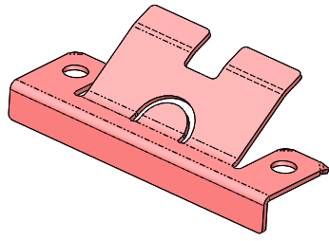
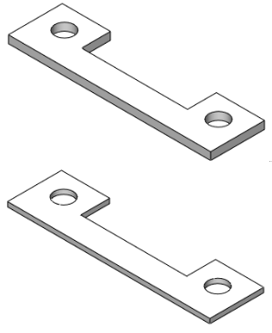
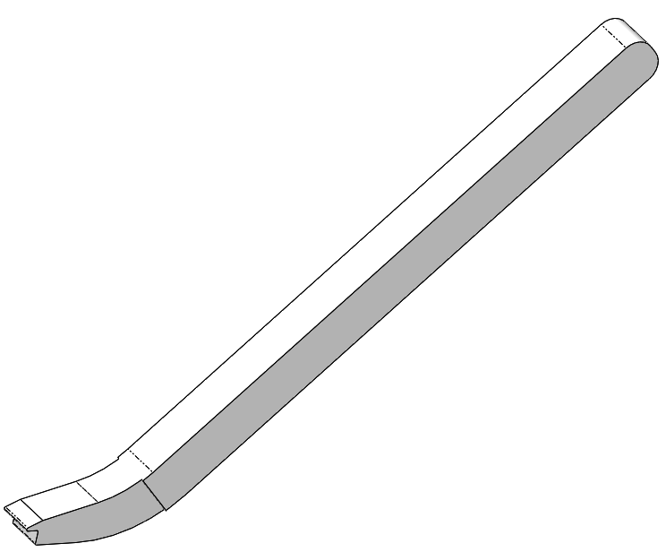
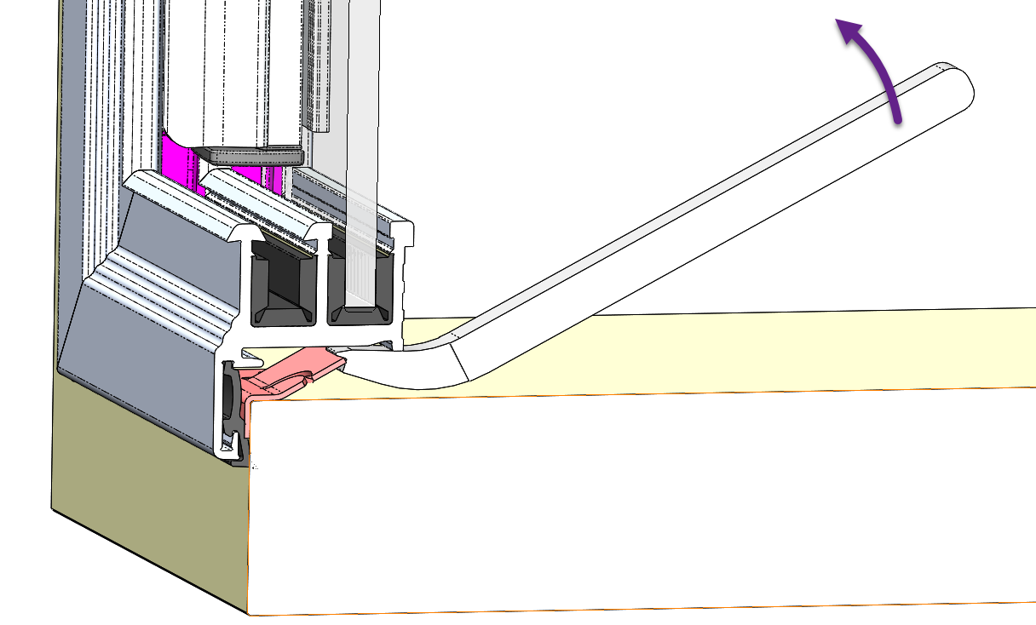
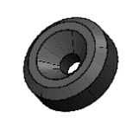
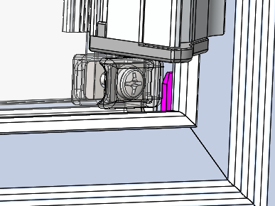
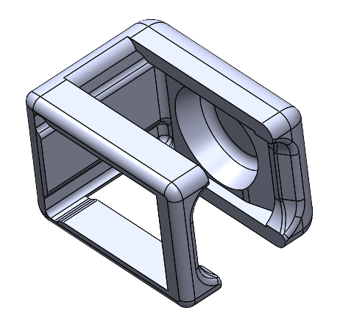
Technical Bulletin
Technical Bulletin#:
TB-LD002
Revision Level:
D
Title:
Life Defender Spare Parts and Accessories
To Provide Information on Spare Parts and Accessories That Austin Stocks for Customers
Purpose:
CF-C-FRAMECLIP-001
(SNAP-IN CLIP FOR FIXED FRAMES)
PURPOSE: This is required to mount all “CFFX” frames.
SOLD INDIVIDUALLY
RECOMMENDATION: Buy in bulk and have available to pre-install into cabinets prior to installation of frames.
CF-C-CLIPSHIM-001-01 (.060” THICK PLASTIC)
CF-C-CLIPSHIM-001-02 (.100” THICK ALUMINUM)
(SHIMS FOR SNAP-IN CLIPS FOR FIXED FRAMES)
PURPOSE: On occasion the cabinet may be just a little too tall for the frame so it will be a little loose. When this occurs, installing these shims under the FRAMECLIPS makes the cabinet smaller and tightens up the frame in the cabinet.
SOLD INDIVIDUALLY
RECOMMENDATION: Buy in bulk and have available to use as needed.
CFFX-REMOVEABLE-TOOL (REMOVAL TOOL FOR FIXED FRAMES)
PURPOSE: This tool is used to remove a Fixed Frame.
SOLD INDIVIDUALLY
RECOMMENDATION: Buy one for each installer.
CF-C-SPACER-001 (SPACER FOR FRAMED DOORS)
PURPOSE: These spacers help position the frames during installation.
SOLD INDIVIDUALLY
RECOMMENDATION: These can be bought in bulk and used when needed.
CF-C-CAP-001 (SCREW COVER FOR REMOVABLE PANELS)
PURPOSE: These are aesthetic parts cover the screws on Gen 3 Panels.
SOLD INDIVIDUALLY
RECOMMENDATION: These can be bought in bulk and used when needed.
Note that information contained in the Technical Bulletin is subject to change without notice. Austin Hardware did its best to convey accurate information herein; however, every situation is unique, and this information is for helpful reference only, and does not warrant any specific actions any end user undertakes relating to this information.

Slide 2
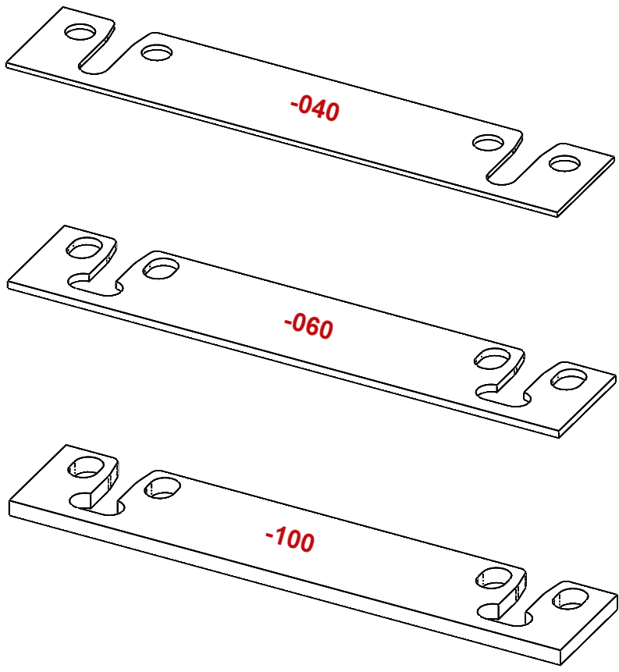
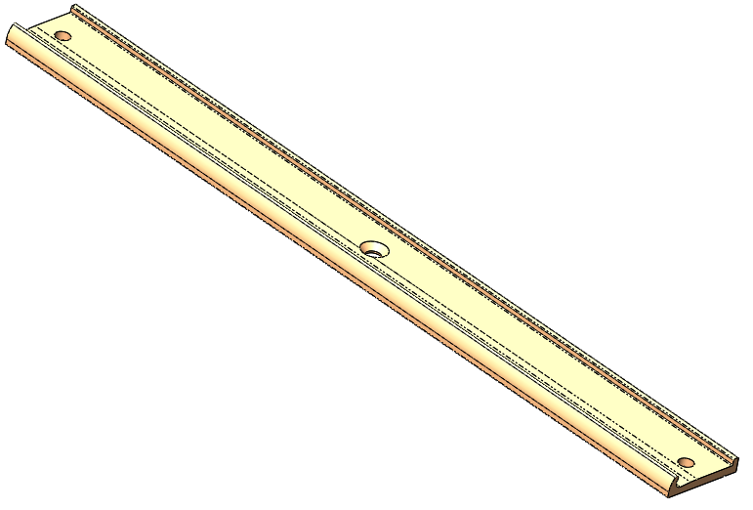
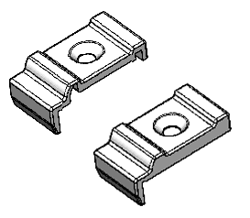
Technical Bulletin
TB-LD002
Rev:
D
Spare Parts and Accessories
CF-C-HG-SHIM-040
CF-C-HG-SHIM-060
CF-C-HG-SHIM-100
(SHIMS FOR HINGED FRAMES)
PURPOSE: These are used with restocker hinges to adjust the frame’s latch relative to the striker. They are also used on CW Doors to adjust squareness or center gap. Use on CFT*, CFL*, CFR*, and CFB* frames.
SOLD INDIVIDUALLY
RECOMMENDATION: Buy in bulk and have available to adjust hinged frames as they are being installed.
CF-C-RSL04-0600 (FOR 6” LATCH)
CF-C-RSL01-1200 (FOR 12” LATCH)
CF-C-RSL01-1800 (FOR 18” LATCH)
CF-C-RSL01-2400 (FOR 24” LATCH)
(STRIKERS FOR RESTOCKER FRAME)
PURPOSE: One of these comes with each latching frame to match the size of the latch on that frame. Occasional one may become lost or damaged.
SOLD INDIVIDUALLY
RECOMMENDATION: Buy a small quantity of the most popular sizes and have them available to installers when needed to replace the occasional lost or damaged striker.
CF-C-RSL-ENDCAP-KIT
(END CAP KIT FOR RSL STRIKER)
PURPOSE: These end caps locate on each end of the striker and properly
locate the striker onto the frame. They can occasionally get lost or damaged.
SOLD AS A KIT
RECOMMENDATION: Buy in bulk and have available to installers when occasionally needed.
Note that information contained in the Technical Bulletin is subject to change without notice. Austin Hardware did its best to convey accurate information herein; however, every situation is unique, and this information is for helpful reference only, and does not warrant any specific actions any end user undertakes relating to this information.

Slide 3
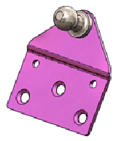
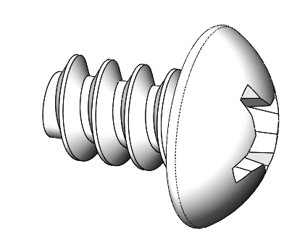
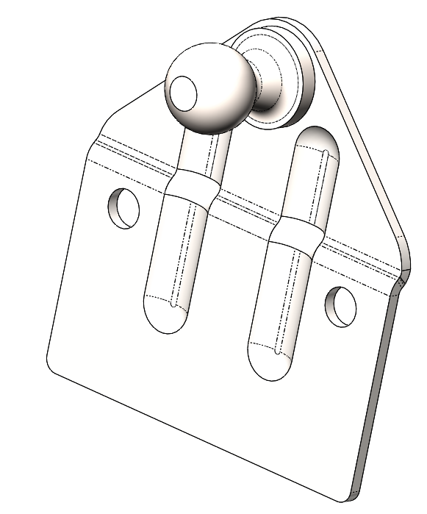
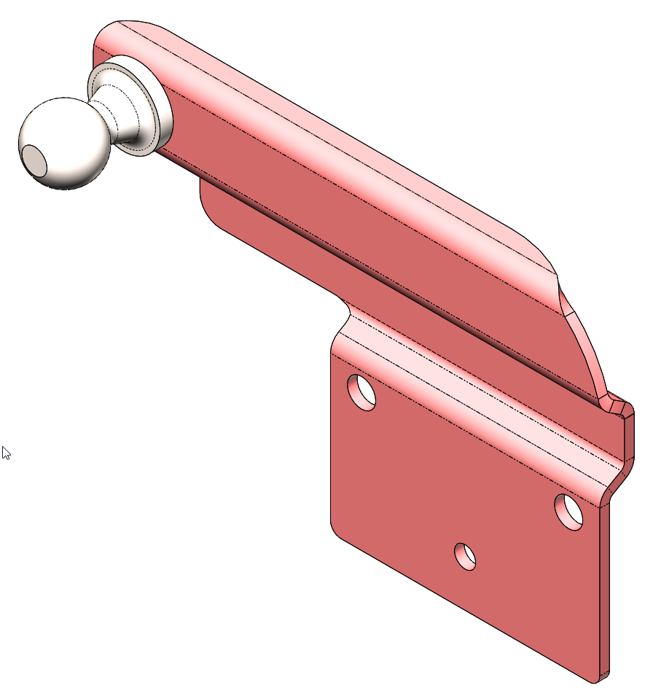
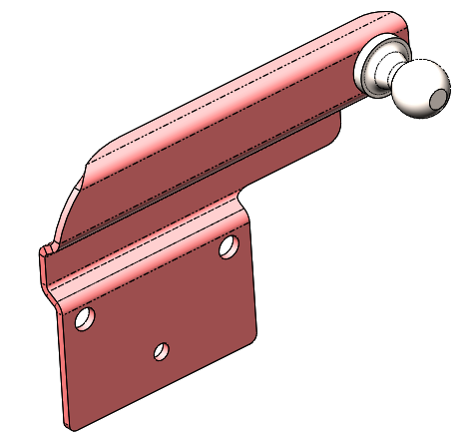
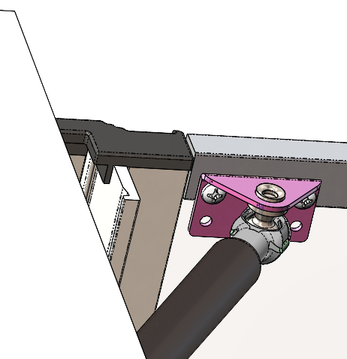
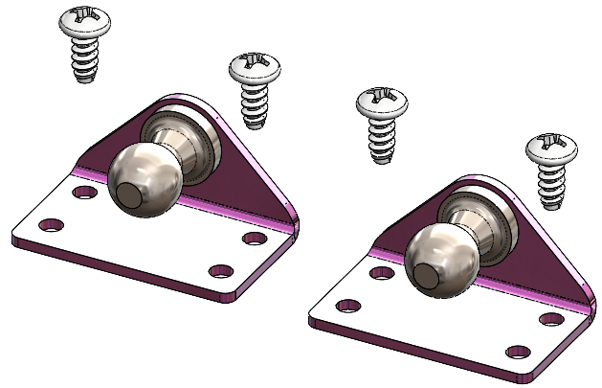
Technical Bulletin
TB-LD002
Rev:
D
Spare Parts and Accessories
CF-C-GSB-A01-FIXED (FIXED BRACKET FOR GAS SPRING CABINET MOUNT)
PURPOSE: These mount in the cabinet and may occasionally get lost or get damaged.
SOLD INDIVIDUALLY
RECOMMENDATION: Buy a small quantity and have them available to installers when needed to replace the occasional lost or damaged bracket.
CF-GSB-KIT-STANDARD (STANDARD MOVING BRACKET KIT - FRAME MOUNT)
PURPOSE: These brackets mount on the frame with screws.
SOLD AS A KIT (2 BRACKETS & 4 SCREWS)
RECOMMENDATION: Buy a small quantity and have them available
to installers when needed to replace a frame bracket.
CF-GSB-KIT-OFFSET (OFFSET MOVING BRACKET KIT FOR SMALL FRAMES)
PURPOSE: These brackets are used on smaller frames and with short
gas springs (<=3” stroke). The ball is offset so the bracket can mount
directly on the frame but allow the ball to be closer to the hinge.
SOLD AS A KIT (1 LH BRACKET, 1 RH BRACKET, & 4 SCREWS)
RECOMMENDATION: Buy a small quantity and have them available
to installers when needed.
RH
LH
CW-GSB-KIT-STANDARD (MOTION CONTROL BRACKET KIT FOR “CW” FRAMES)
PURPOSE: These brackets are used to add motion control to a “CW” frame. They mount to the back of a CW frame on the sides and are used with an appropriate set of Gas Springs and Fixed Brackets (CF-C-GSB-A01-FIXED).
SOLD AS A KIT (2 BRACKETS & 4 SCREWS)
RECOMMENDATION: Buy a small quantity and have them available to installers when needed.
Note that information contained in the Technical Bulletin is subject to change without notice. Austin Hardware did its best to convey accurate information herein; however, every situation is unique, and this information is for helpful reference only, and does not warrant any specific actions any end user undertakes relating to this information.

Slide 4
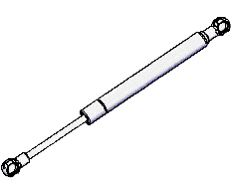
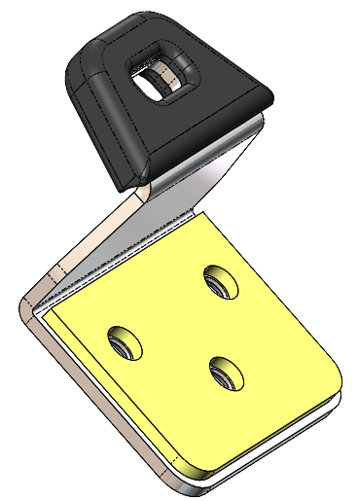
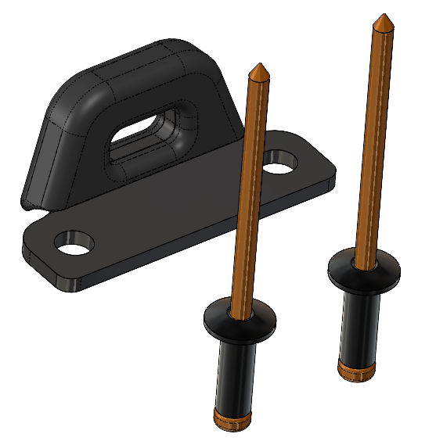
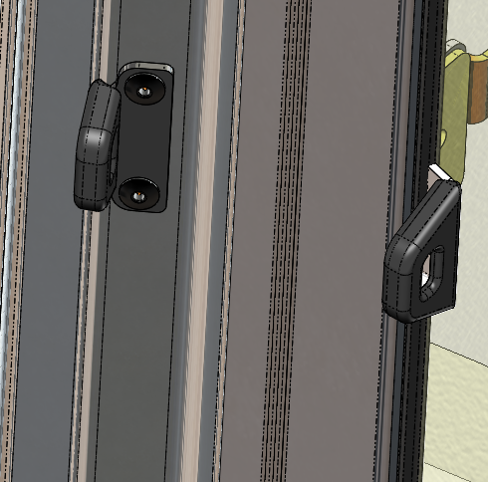
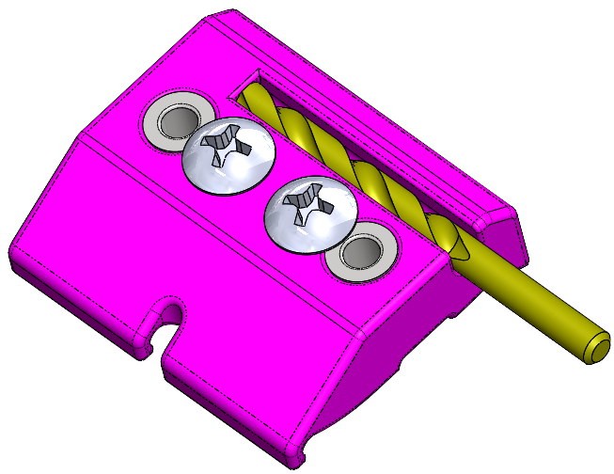
Technical Bulletin
TB-LD002
Rev:
D
Spare Parts and Accessories
GAS SPRINGS (VARIOUS SIZES)
PURPOSE: Each restocker cabinet comes with gas springs designed for that size and weight, but they may occasionally get lost or damaged, or the end user may want a different opening angle.
SOLD INDIVIDUALLY
Commons Sizes:
GSS 1713UE – 7.50” XL; 2.20” STROKE, 18#
GSS 1777UC -- 12.01” XL; 4.25” STROKE; 18#
GSS 1791UU – 15.00” XL; 5.50” STROKE 18#
GSS 1792UP – 15.00” XL; 5.50” STROKE; 29#
GSS 1801UN – 17.20” XL; 7.00” STROKE; 29#
RECOMMENDATION: There are several varieties of gas springs used on frames and they are kept in stock at Austin. Since the need for these should be infrequent, we recommend only ordering when needed.
CF-TAGBRACKET-A05
(GEN 3 INVENTORY CONTROL BRACKET - CABINET)
PURPOSE: This bracket mounts on the cabinet and allows a “CF” frame to be locked out (with a control tag). Use on CFT*, CFL*, CFR*, and CFB* frames.
SOLD INDIVIDUALLY
RECOMMENDATION: Buy in bulk and have available to install when needed.
CF-TAGBRACKET-A06KIT
(GEN 3 INVENTORY CONTROL BRACKET - HANDLE)
PURPOSE: This allows a “CF” frame with sliders to be locked out (with a control tag).
Use on CFT*, CFL*, CFR*, and CFB* frames when a customer requires it.
SOLD INDIVIDUALLY
RECOMMENDATION: Buy in bulk and have available to install when needed.
CF-JIG-TBG3-128
(GEN 3 TAG BRACKET HANDLE HOLE DRILL JIG)
PURPOSE: This jig locates on the Gen 3 Slider Handle and drills two properly spaced 1285” diameter holes in the handle to allow the Gen 3 Handle Tag Bracket to be attached with rivets.
SOLD INDIVIDUALLY
RECOMMENDATION: Buy one for each installer.
Note that information contained in the Technical Bulletin is subject to change without notice. Austin Hardware did its best to convey accurate information herein; however, every situation is unique, and this information is for helpful reference only, and does not warrant any specific actions any end user undertakes relating to this information.

Slide 5
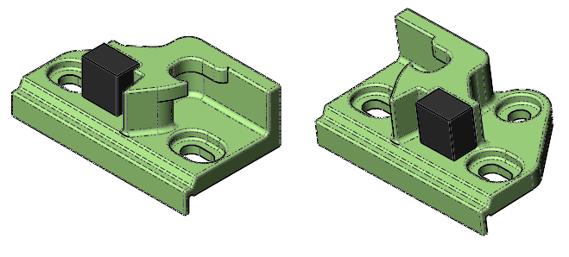
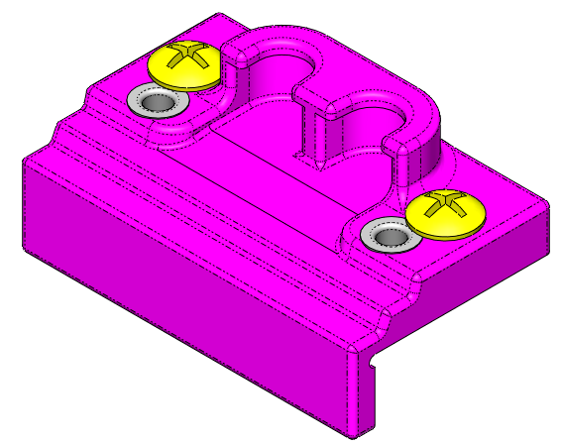
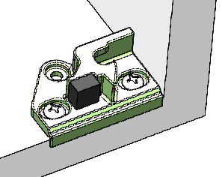
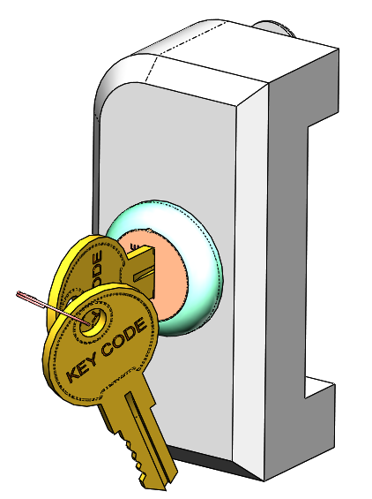
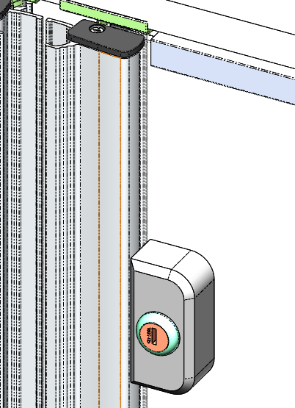
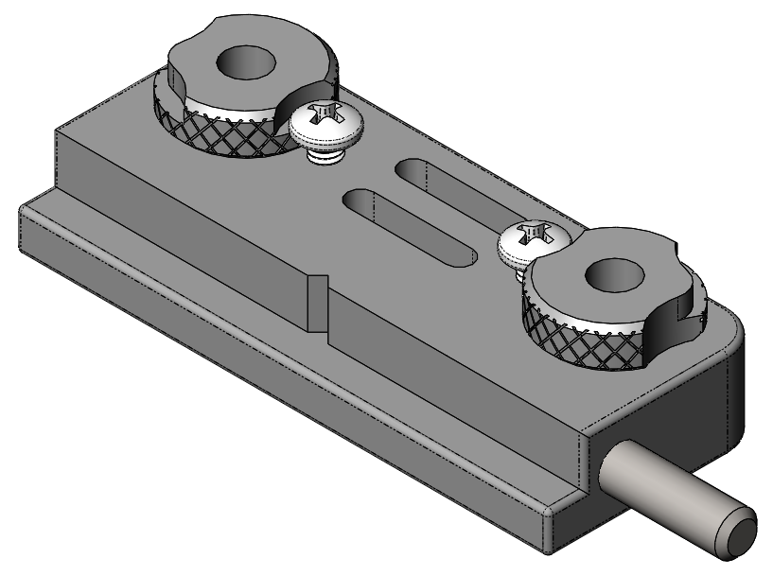
Technical Bulletin
TB-LD002
Rev:
D
Spare Parts and Accessories
CW-STRIKERKIT-A01
(STRIKER KIT FOR GEN II DOOR)
PURPOSE: These strikers are used with Gen II Doors.
SOLD AS A KIT
RECOMMENDATION: Keep a few kits to keep in case a striker is lost.
CW-JIG-STRIKER-001
(GEN II STRIKER MOUNT JIG)
PURPOSE: This jig locates the position of the Gen II Strikers, allows you to drill pilot holes in the correct locations, and allows you to adjust the striker head height.
SOLD INDIVIDUALLY
RECOMMENDATION: Buy one for each installer.
CW and CU LOCK KITS
CW-LOCKKIT-LB-XXXX (LATCH ON BOTTOM)
CW-LOCKKIT-LT-XXXX (LATCH ON TOP)
CW-LOCKKIT-LL-XXXX (LATCH ON LEFT)
CW-LOCKKIT-LR-XXXX (LATCH ON RIGHT)
Key Codes available are AH01 and CH545
PURPOSE: When installed, these lock “CW” and “CU” doors. Includes attaching screws. Order lock based on the position of the latch it will lock.
SOLD INDIVIDUALLY
RECOMMENDATION: Buy individually as needed.
CW-LOCKJIG-A257
(GEN II LOCK MOUNT JIG)
PURPOSE: This jig locates and drills the mounting holes required to attach the Gen II Lock Assembly.
RECOMMENDATION: Buy one for reach installer.
Note that information contained in the Technical Bulletin is subject to change without notice. Austin Hardware did its best to convey accurate information herein; however, every situation is unique, and this information is for helpful reference only, and does not warrant any specific actions any end user undertakes relating to this information.

Slide 6
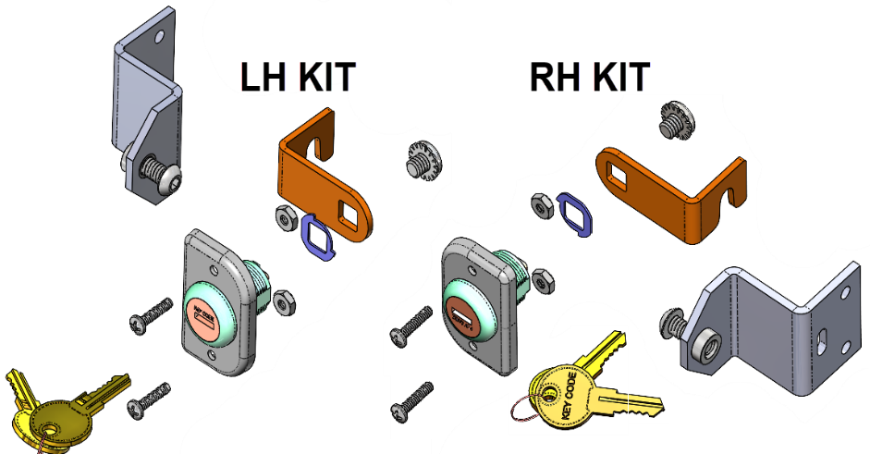
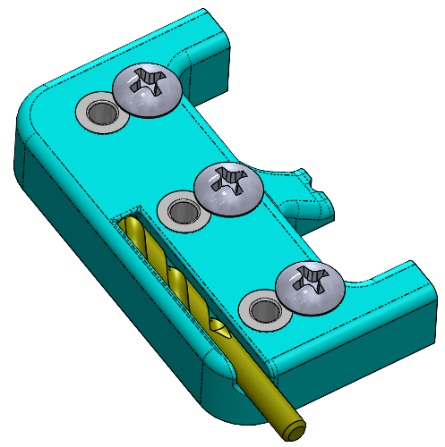
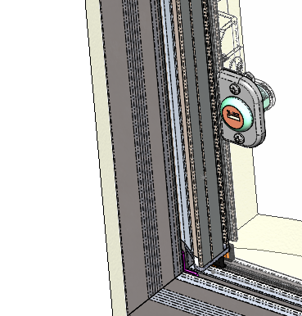
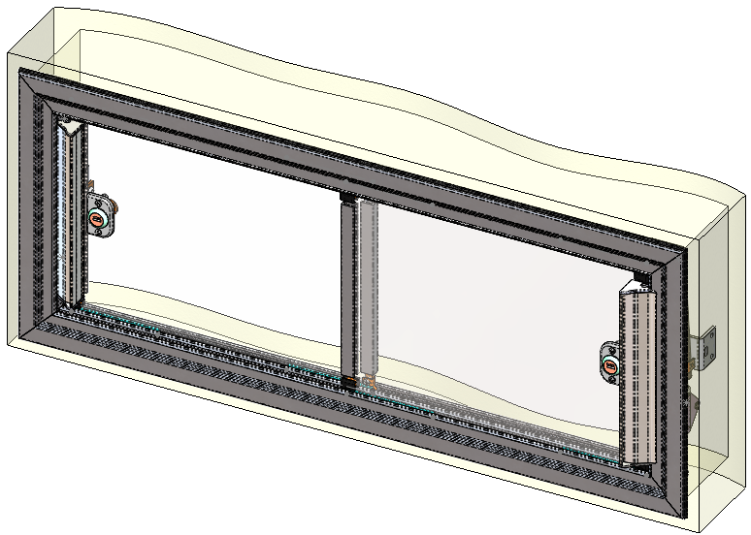
Technical Bulletin
TB-LD002
Rev:
D
Spare Parts and Accessories
CF LOCKING KITS
CF-LK-LOCKKIT-LH-XXXX (LOCK ON LEFT)
CF-LK-LOCKKIT-RH-XXXX (LOCK ON RIGHT)
Key Codes available are AH01 and AH02
PURPOSE: These locks work with “CF” Doors.
SOLD AS KITS INCLUDING STRIKER ASSY
RECOMMENDATION: For “CF” frames with Sliding Doors, order one LH Kit and one RH Kit. For Fixed Fames, order one LH or RH kit as appropriate.
CF-LOCKJIG-A136
(“CF” LOCK MOUNT DRILL JIG)
PURPOSE: This jig locates and drills the mounting holes required to attach the Gen 3 “CF” Lock Assembly.
RECOMMENDATION: Buy one for reach installer.
Note that information contained in the Technical Bulletin is subject to change without notice. Austin Hardware did its best to convey accurate information herein; however, every situation is unique, and this information is for helpful reference only, and does not warrant any specific actions any end user undertakes relating to this information.

